Slide 1
Delegation, Inheritance versus Parameterized Types
Samuel Gerard, Graham Parker & Sam Clement

Slide 2
Delegation
Delegation is using composition for reusability instead of inheritance. It allows new functionality to be added flexibly at run time from existing objects rather than defining subclasses.
“An implementation mechanism in which an object forwards or delegates a request to another object. The delegate carries out the request on behalf of the original object.”
“In delegation, two objects are involved in handling a request: a receiving object delegates operations to its delegate. This is analogous to subclasses deferring requests to parent classes.”
Several design patterns including most notably Strategy rely on delegation.
“In the Strategy pattern, an object delegates a specific request to an object that represents a strategy for carrying out the request.”
Design Patterns, Elements of Reusable Object-Oriented Software

Slide 3
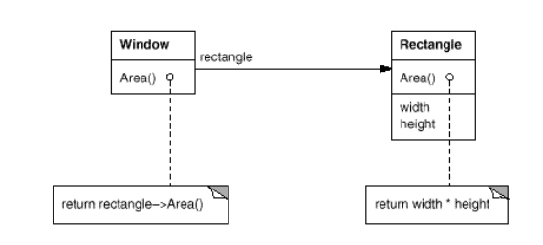
Example
A plain arrowhead line shows that Window has a reference to an instance of Rectangle.
It doesn’t inherit from Rectangle which means it can easily be swapped and that the rectangle can be used elsewhere (not relevant in this example)

Slide 4
Delegation
Advantages: “The main advantage of delegation is that it makes it easy to compose behaviours at run-time and to change the way they're composed. Our window can become circular at run-time simply by replacing its Rectangle instance with a Circle instance, assuming Rectangle and Circle have the same type.”
Disadvantages: “Dynamic, highly parameterized software is harder to understand than more static software. There are also run-time inefficiencies, but the human inefficiencies are more important in the long run.”
“Heavy use of object composition can make designs harder to understand.”

Slide 5
Inheritance
“A relationship that defines one entity in terms of another. Class inheritance defines a new class in terms of one or more parent classes. The new class inherits its interface and implementation from its parents. The new class is called a subclass. Class inheritance combines interface inheritance and implementation inheritance. Interface inheritance defines a new interface in terms of one or more existing interfaces. Implementation inheritance defines a new implementation in terms of one or more existing implementations.”
Design Patterns, Elements of Reusable Object-Oriented Software

Slide 6
Inheritance
Advantages: “Class inheritance is defined statically at compile-time and is straightforward to use, since it’s supported directly by the programming language.” “Class inheritance also makes it easier to modify the implementation being reused.”

Slide 7
Inheritance
Disadvantages: “You can't change the implementations inherited from parent classes at run-time, because inheritance is defined at compile-time.” “The implementation of a subclass becomes so bound up with the implementation of its parent class that any change in the parent's implementation will force the subclass to change.” “Implementation dependencies can cause problems when you're trying to reuse a subclass. Should any aspect of the inherited implementation not be appropriate for new problem domains, the parent class must be rewritten or replaced by something more appropriate.” “One cure for this is to inherit only from abstract classes, since they usually provide little or no implementation.”

Slide 8
Parameterized Types
A type that leaves the type unspecified. The type is supplied as a parameter at the point of use. Allows the same code to be used with multiple types. In C++ & C# this is called templating or Generics and is used by writing <T> .
“This technique lets you define a type without specifying all the other types it uses. The unspecified types are supplied as parameters at the point of use.”
Not specifically used in any design pattern and only really has relevance in static typed languages.
Design Patterns, Elements of Reusable Object-Oriented Software

Slide 9
Parameterized Types
Advantage: Allows for easy reusability.
Disadvantage: Cant change at run time.

Slide 10
When to use
Delegation is a good design choice only when it simplifies more than it complicates. Object composition lets you change the behaviour being composed at run-time, but it also requires indirection and can be less efficient.
Inheritance lets you provide default implementations for operations and lets subclasses override them.
Parameterized types let you change the types that a class can use.
But neither inheritance nor parameterized types can change at run-time. Which approach is best depends on your design and implementation constraints.

